Slide 1
NYC Taxi Data Project
Sample presentation

Slide 2
Outline
Introduction present data and your analysis/research goal
Data visualization single feature and feature relationship
Data cleaning outlier detection and missing data handling
Use of external data bonus point
Idea/data validation pilot analysis
Method and model
Result
Conclusion summarise and improvement proposal

Slide 3
Introduction
The goal of this analysis to use the New York City Taxi dataset to evaluate the potential information leakage from the Federal Reserve around FOMC meetings along unofficial channel.
The filtered sample spans 1425 weekdays or 91.1% of all weekdays from the beginning of 2009 through the end of 2014. In the total, the sampled data contains 1.5 million observations. Each row contains one taxi trip.
In the comment, write down your reasons and criterion for data sampling
Notes:
The taxi dataset begins on 1 January 2009, and data with GPS coordinates are available. Later data are available but at a very low spatial resolution. I select an earlier end point due to concerns over the impact of Uber on the use of taxis for Fed interactions.
To maximise the probability that taxi rides are linked to Fed and commercial-bank insiders, I omit weekends except for the early hours of Saturday morning.

Slide 4
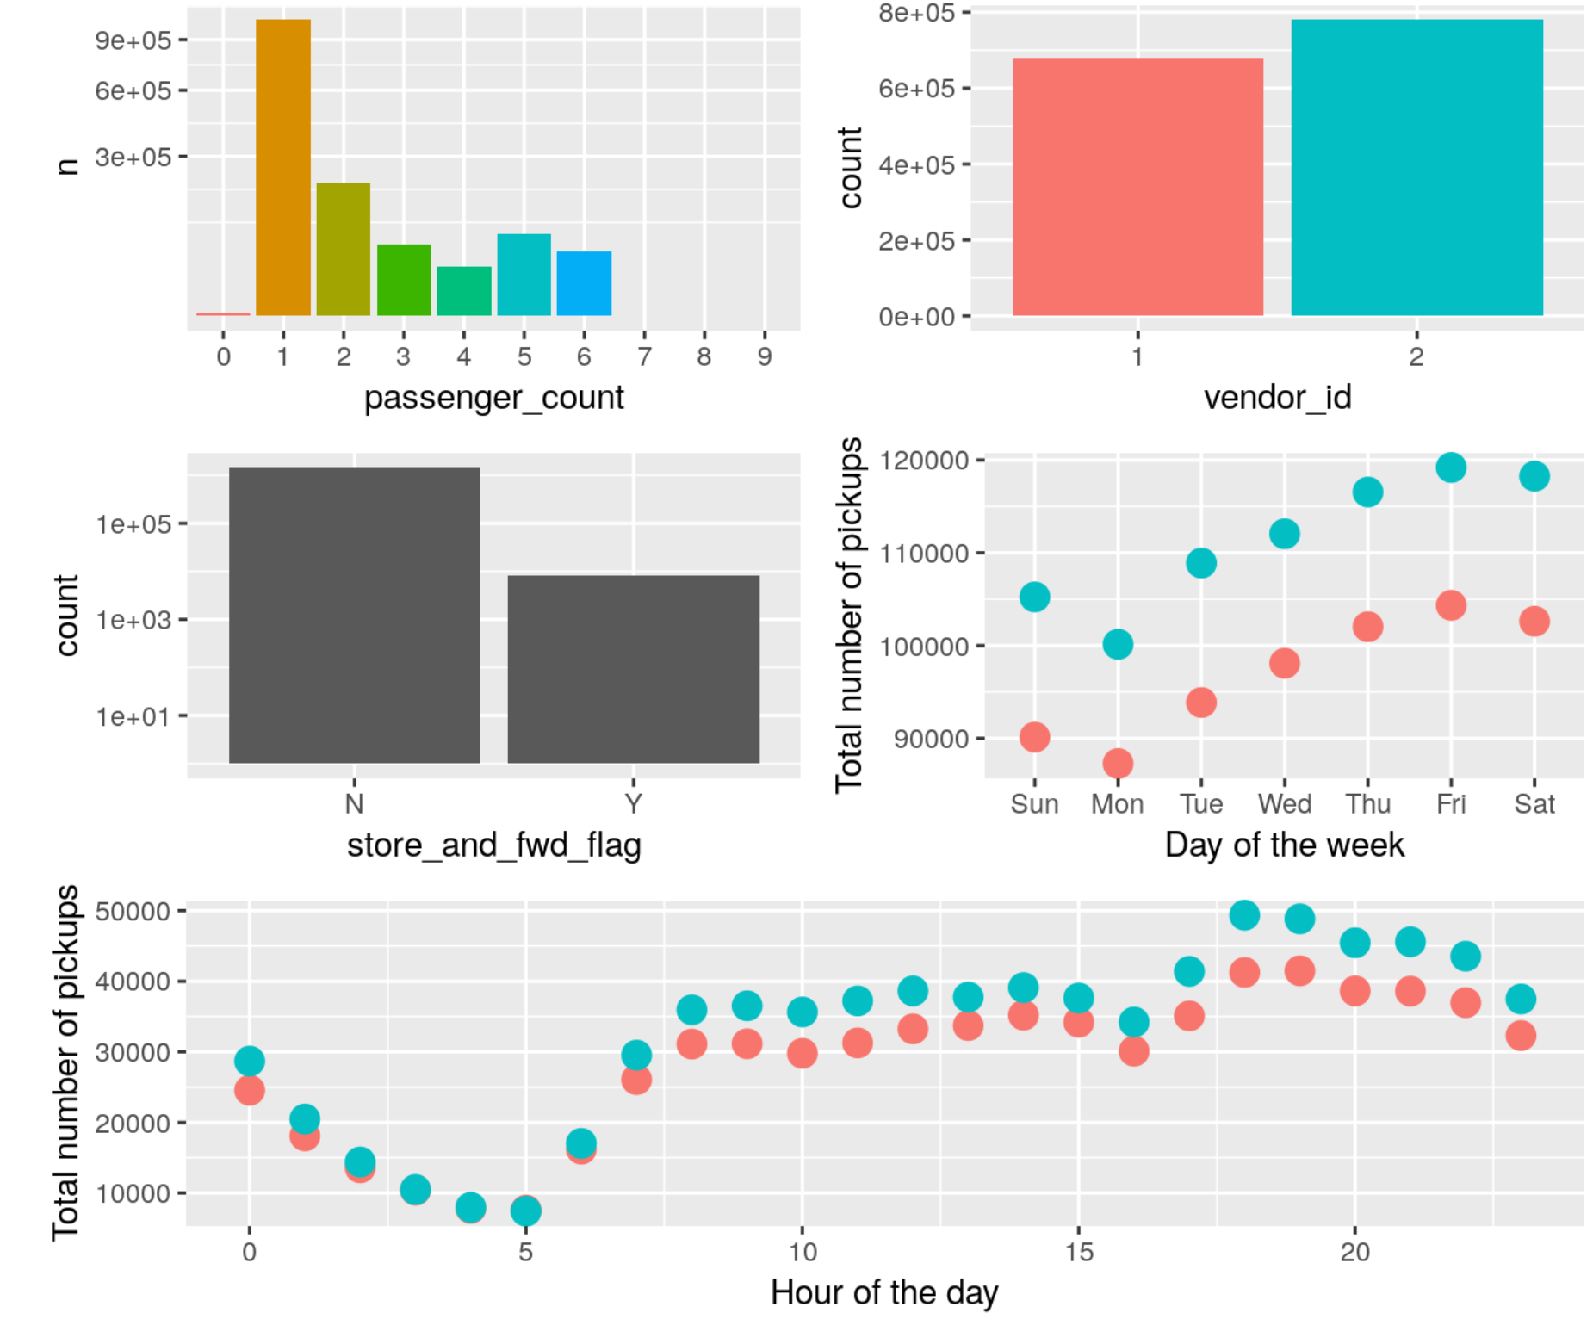
Data visualization
Put more explanations on abnormality finding.
We find:
There are a few trips with zero, or seven to nine passengers.
The vast majority of rides had only a single passenger, with two passengers being the (distant) second most popular option.
Towards larger passenger numbers we are seeing a smooth decline through 3 to 4, until the larger crowds (and larger cars) give us another peak at 5 to 6 passengers.
Vendor 2 has significantly more trips in this data set than vendor 1 (note the logarithmic y-axis). This is true for every day of the week.
We find an interesting pattern with Monday being the quietest day and Friday very busy. This is the same for the two different vendors, with vendor_id == 2 showing significantly higher trip numbers.
Notes:
For the first point, in particular, we see 60 trips with 0 passenger, 3 trips with 7 passengers, 1 trip with 8 passengers and 1 trip with 9 passengers.

Slide 5
Data cleaning
Follow the outline:
Scenario
Decision
Provide more details in the comments if necessary.
Extreme trip duration
Longer than one day
These value should be removed
Close to 24 hours
We will remove trip_durations longer than 22 hours
Shorter than a few minutes
Zero distance trip
We will remove those zero-distance trips that took more than a minute for our continued analysis.
Short trips with above zero distance
We impose a lower trip_duration limit of 10 seconds and a (very conservative) speed limit of 100 km/h (62 mph).

Slide 6
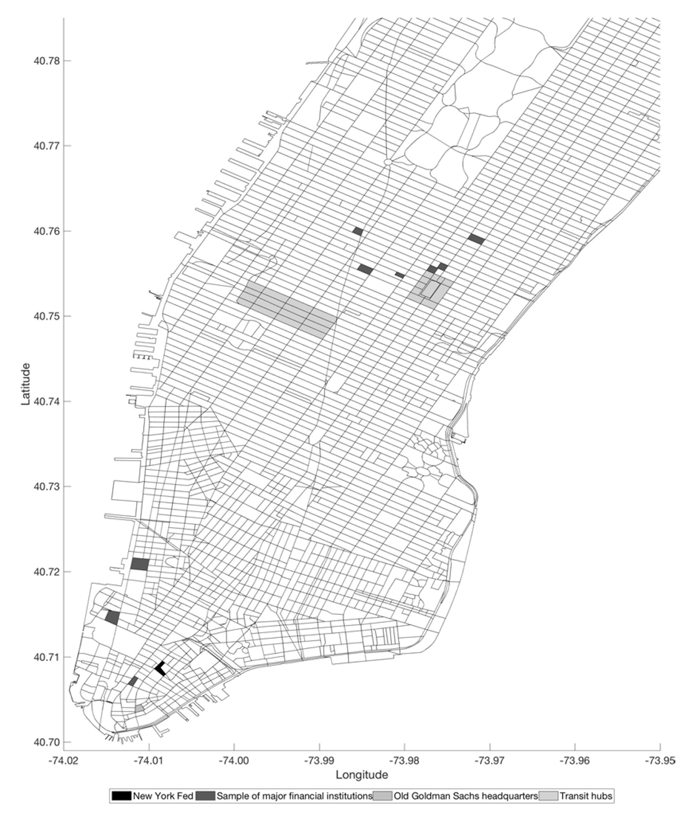
Use of external data source
The New York Fed’s headquarters are located at 33 Liberty Street.
Location of major bank headquarters are marked in the figure.
Filter the trips with pick-up and drop-off location close to FRBNY and commercial banks.
Source of external data
How to use external data to do feature/data engineer

Slide 7
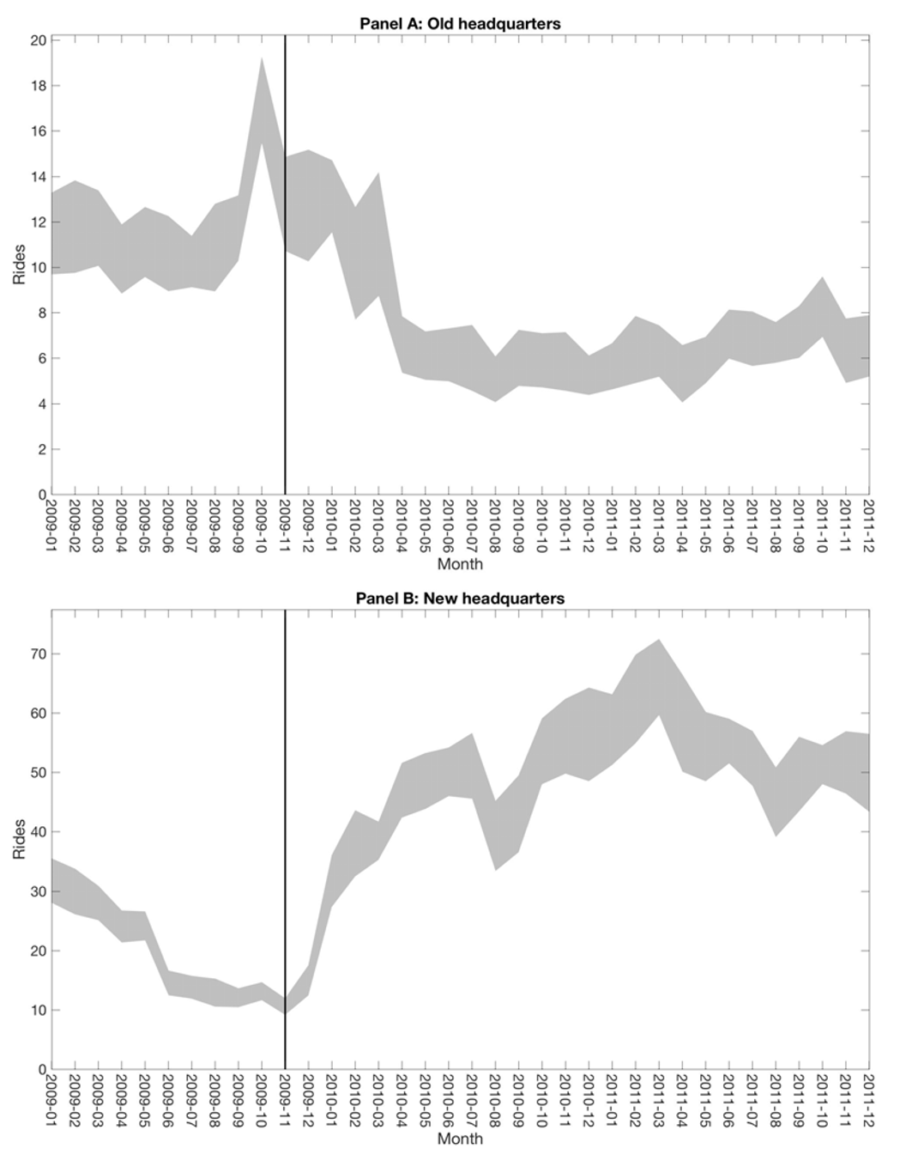
Data validation
Goldman Sachs relocated its headquarters from 85 Broad Street to 200 West Street, and I seek an indication of whether taxi rides reflect the movement of business activity from the old headquarters to the new headquarters.
Validation step:
Data consistency
Validation of ideas

Slide 8
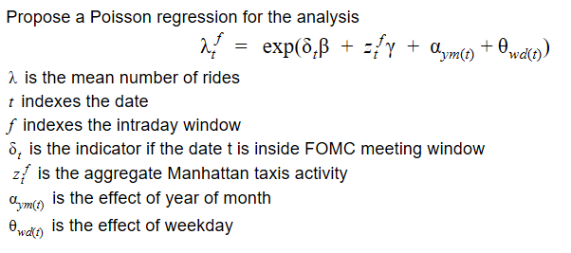
Method and model
Clearly state your model and how to use your model
Perform t-test or bootstrap test on coefficient beta to see the change in rides from major commercial banks to FRBNY during FOMC window.

Slide 9
Result
Clearly present the stats/modeling result and its effect on answering business question.
 | Model 1 | Model 2
Coefficient | 0.49 | 3.87
Test statistics | 4.70 | 0.7
p-value | < 0.001 | < 0.001
Model 1 and Model 2 used different models to estimate the year-month and weekday effects. Under both model, we see a significant effect of beta coefficient, suggesting that there is an increase of direct rides between major commercial banks and FRBNY during FOMC window.

Slide 10
Conclusion
Employed a rich dataset constructed from anonymous trip-level taxi data to examine interactions between insiders of the Federal Reserve Bank of New York and major commercial banks around FOMC meetings.
Found evidence suggestive of an increase in rides between them both at the New York Fed’s offices and in areas.
More improvement can be made by further segmenting time of day, especially during lunch and dinner time.
Summarize what you achieved and propose one or two direction you can further explore.

